Slide 1
WELCOME
Weekly Report
Vatsla Adhikari
Dec. 22, 2023

Slide 2
INDEX
Slide 1: Weekly Report
Slide 2: Index
Slide 3: Objective
Slide 4: Code API Table and Summary
Slide 5-8: Code Explanation
Slide 9-11: 3 Sample Outputs
Slide 12-13: Additional Project

Slide 3
Objective: To extract the detected object (particle) from the entire image provided by the sensor and do processing on the extracted object. Done via OpenCV.

Slide 4
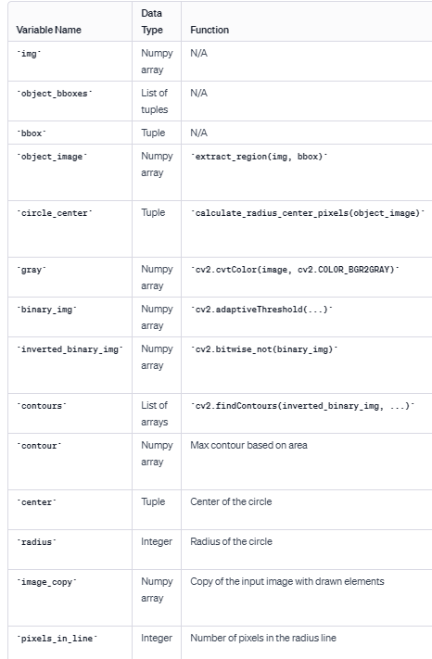
Objective: Code API Table, Summary
Summary:
API Table
extract_region(img, bbox):
  Input: Original image (img), bounding box coordinates (bbox).
  Output: Extracted region of the image specified by the bounding box.
calculate_radius_center_pixels(image):
  Input: Extracted region image (image).
  Output: Center and radius of the circle drawn on the image, along with the number of pixels in the radius line.
display_image(image, title, circle_center=None) (not shown, assumed to be in the 'display' module):
  Input: Image (image), title for display (title), optional circle center (circle_center).
  Output: Display the image with the specified title, and optionally with the circle and center.
These functions collectively extract regions from an image, draw circles, display images, and provide information about the drawn circle,
such as its center, radius, and the number of pixels in the radius line.

Slide 5
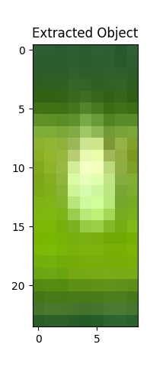
Objective: Code Explanation
def extract_region(img, bbox):
x_center, y_center, width, height = bbox[1], bbox[2], bbox[3], bbox[4]
image_height, image_width, _ = img.shape
x = int((x_center - width / 2) * image_width)
y = int((y_center - height / 2) * image_height)
w = int(width * image_width)
h = int(height * image_height)
return img[y:y + h, x:x + w]

Slide 6
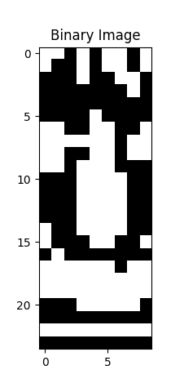
Objective: Code Explanation
# Convert the image to grayscale
gray = cv2.cvtColor(image, cv2.COLOR_BGR2GRAY)
# Apply adaptive thresholding
binary_img = cv2.adaptiveThreshold(gray, 255, cv2.ADAPTIVE_THRESH_GAUSSIAN_C, cv2.THRESH_BINARY, 9, 2)

Slide 7
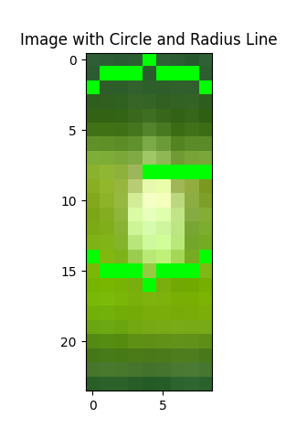
Objective: Code Explanation
inverted_binary_img = cv2.bitwise_not(binary_img)
# Find contours
contours, _ = cv2.findContours(inverted_binary_img.copy(), cv2.RETR_EXTERNAL, cv2.CHAIN_APPROX_NONE)
# Assuming there is only one contour, get its properties
if contours:
contour = max(contours, key=cv2.contourArea)
(x, y), radius = cv2.minEnclosingCircle(contour)
center = (int(x), int(y))
radius = int(radius)
print("Radius = ",radius)
print("Center: x=",x," y=",y)
# Draw the circle on a copy of the original image
image_copy = image.copy()
cv2.circle(image_copy, center, radius, (0, 255, 0), 1) # (0, 255, 0) is the color, 2 is the thickness
# Draw the radius line
x_line = int(center[0] + radius * np.cos(np.radians(0)))
y_line = int(center[1] + radius * np.sin(np.radians(0)))
cv2.line(image_copy, center, (x_line, y_line), (0, 255, 0), 1) # Draw radius line in green
# Display the image with the drawn circle and radius line
display_image(image_copy, 'Image with Circle and Radius Line')

Slide 8
Objective: Code Explanation
Main
# Calculate radius, center, and pixels in the radius line
circle_center = calculate_radius_center_pixels(object_image)
# Display the image with the circle and center
display_image(object_image, 'Object with Circle and Center', circle_center)
Processing
pixels_in_line = 0
for i in range(int(radius)):
x_line = int(center[0] + i * np.cos(np.radians(0)))
y_line = int(center[1] + i * np.sin(np.radians(0)))
if cv2.pointPolygonTest(contour, (x_line, y_line), False) >= 0:
pixels_in_line += 1
print("Pixels in the radius line =", pixels_in_line)
return center, radius
Display
# Draw the circle and center if provided
if circle_center:
center, radius = circle_center
# Draw the circle
circle = plt.Circle(center, radius, color='r', fill=False)
plt.gca().add_patch(circle)
# Draw the center
plt.scatter(center[0], center[1], c='b', marker='x', s=100)
plt.show()

Slide 9
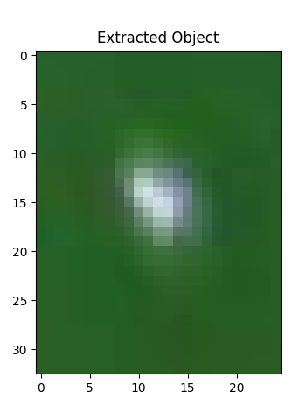
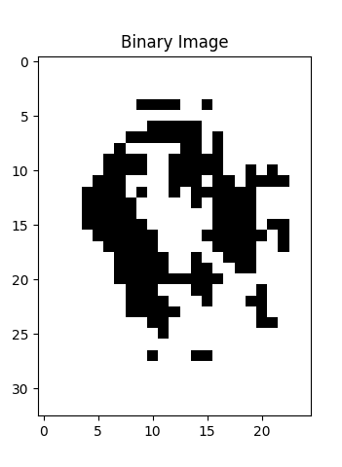
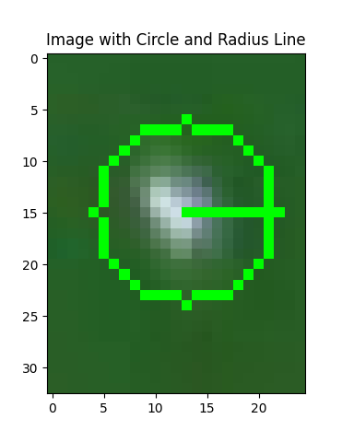
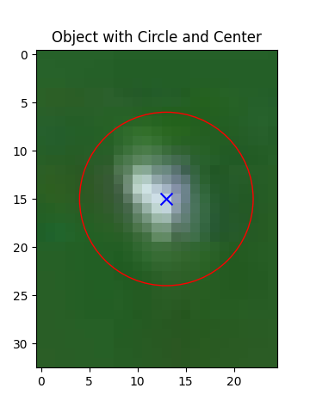
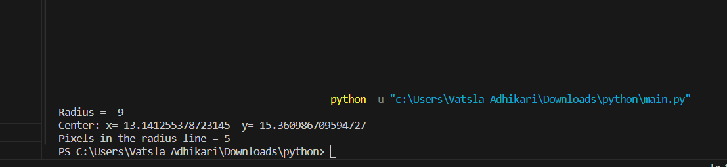
Objective: Output1

Slide 10
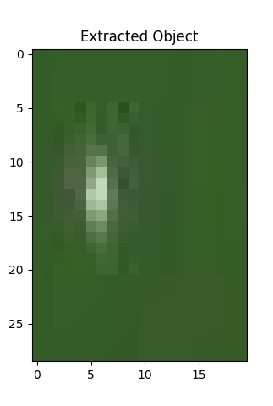
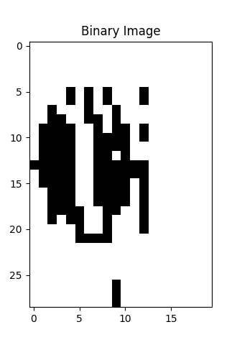
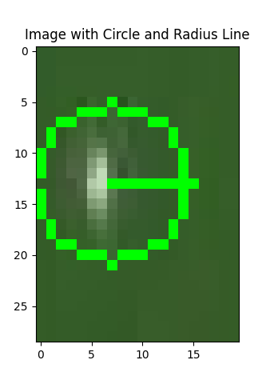
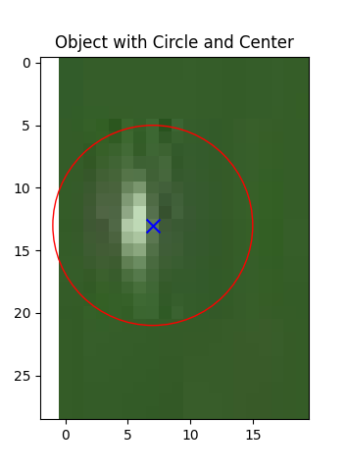
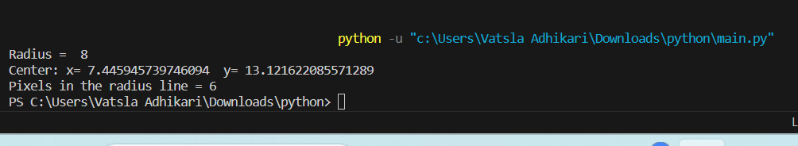
Objective: Output2

Slide 11

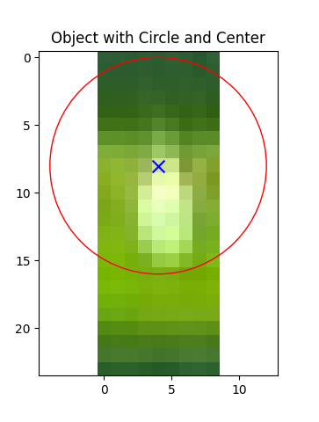
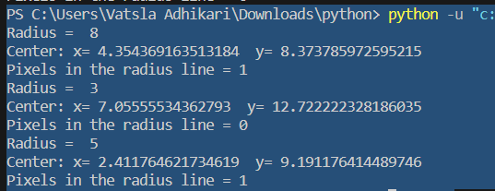
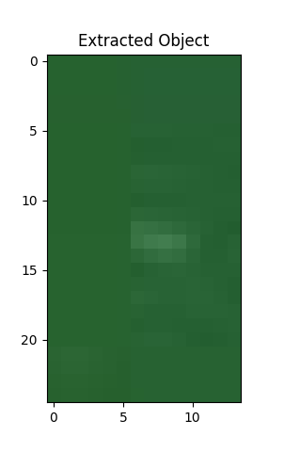
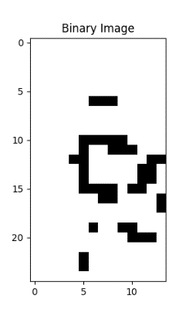
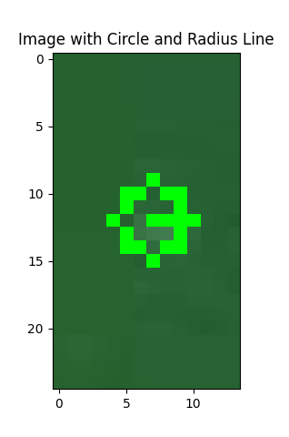
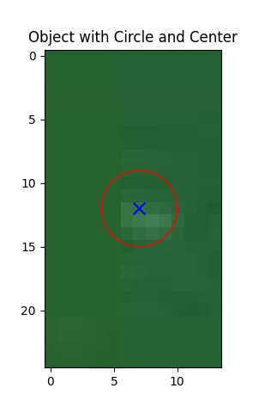
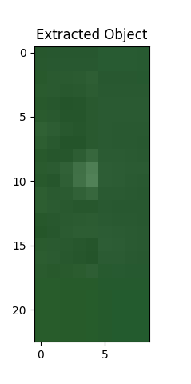
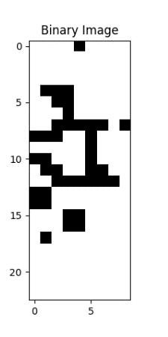
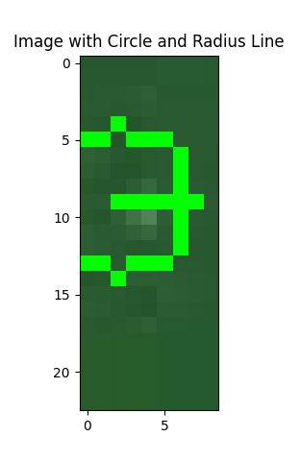
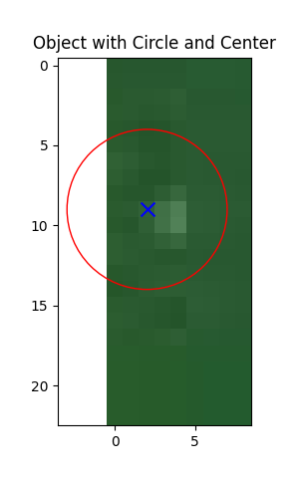
Objective: Output3
(Multiple particles in an image)

Slide 12
Objective: Additional Project
Problem Statement: As students, we often find ourselves fatigued by the repetitive task of filling out multiple placement forms with nearly identical details.
It's a universal challenge we all face.
To address this, I dedicated a short three-hour window to craft a Python solution that can significantly ease this burden.
The code and details mentioned:
https://github.com/vatsla1601/autofuill_placement_form/

Slide 13
Objective: Visual Output
https://www.loom.com/share/66a0f0ad46e4441197a6845ed7ff8f00?sid=1fe93178-3a26-4854-9caf-a7e7169d020b
Kindly see the output, clickable.

Slide 14
Objective: Thank you!
<3
That’s my last weekly report at REC.
Thank you for having me.

Slide 15
Thank You!
REC Technology
Corporation
瑞柯科技
股份有限公司

